Slide 1

Future Organizations

Slide 2

Core/Central Idea
TRADITIONAL
FUTURISTIC

Slide 3
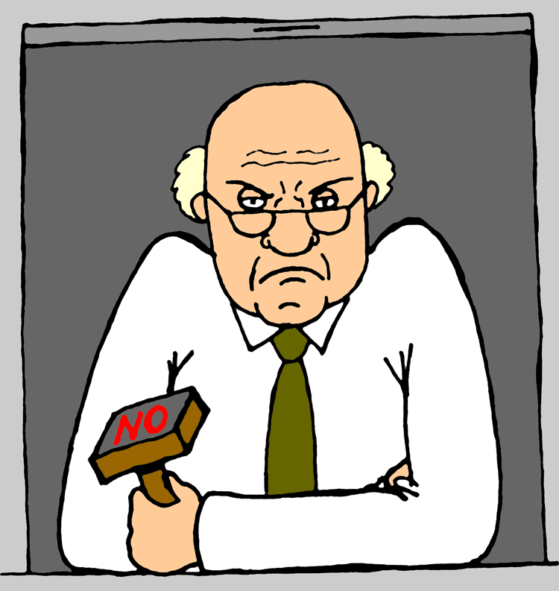
Traditional organizations

Slide 4
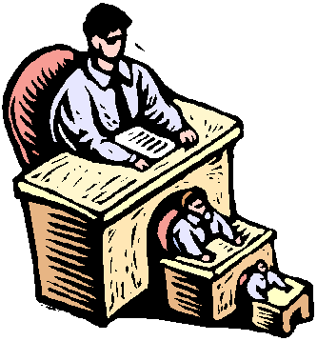
Shortcomings in traditional organizations
Bureaucratic
Slow
Chain of command
Communication Barriers

Slide 5

The average company will be smaller employing fewer people
suffocate
Large organizations stifle innovation…!!!
Separate start-up for a new product
(Tom Rogers, president, Cypress semiconductor, California)

Slide 6

The traditional organizational structure will become more team-based and “Boundary-less”
No separate departments, employees can interact with anyone (Jack Welch, Chairman, GE)
Interdepartmental communication
Not sticking to the chain of command
Cross functional teams

Slide 7

Employees will be empowered to make more decisions
Upside down organizations (Karl Albrecht)
  -Managers serving frontline employees
  -Frontline employees serving customers
Worker commitment
Responding quickly to customer’s demand
Higher order thinking

Slide 8
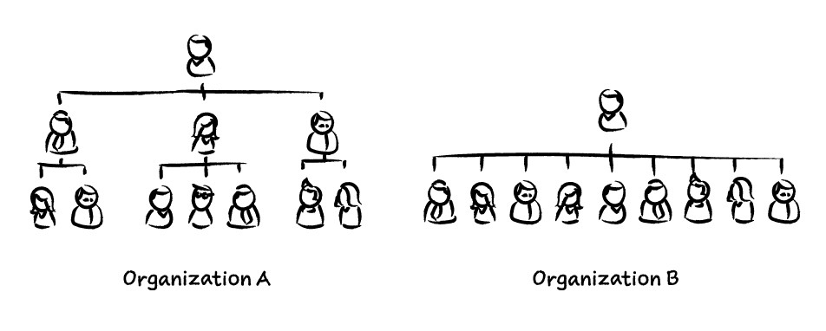
Flatter organizations will be the norm
Managers less meddling in the work of subordinates
3-4 levels
More autonomy

Slide 9

Work itself – on the factory floor, in the office – will be organized around teams and process rather than specialized functions
Part of Multifunctional teams
Manage their own budgets and quality
Workers not doing only a specified job

Slide 10

The bases of power will change
No formal positions or authority to get the work done (Rosabeth Moss Kanter, management theorist)
Managers will have to win the respect

Slide 11

The new organization will be knowledge based
Managers will help the employees get their job done through training and coaching
Manager is not the boss, but sponsor, team leader or internal consultant
Highly trained and educated professionals
Sharing of information
Joint decision making
Direct and discipline their own activities

Slide 12

The new company will stress vision and values
Formulating clear vision and values

Slide 13

Managers must be change agents
Not maintaining the status quo
Fast and adaptable

Slide 14
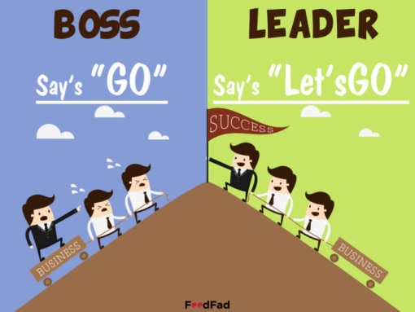
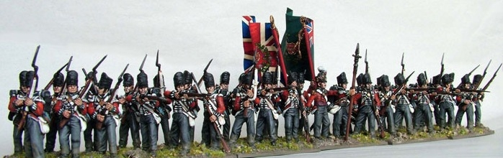
Leadership will be more important
Empowering
Takin the blame
Eating in last
In the firing line

Slide 15


Challenges for current organizations
Globalization of markets and competition
Explosion of technological innovation
Deregulation
Changing demographics
New political systems

Slide 16

These challenges lead to
Uncertainty, turbulence and rapid change
More consumer choices
Mergers and divestitures
Joint ventures
More complexity
Short product life cycles
Market fragmentation
More uncertainty for managers
Record number of business failures

Slide 17

So companies must be
Fast, responsive and adaptive
Flat organizations
Downsized
Quality conscious
Empowered
Smaller units
Decentralized
Human capital oriented
Boundary-less
Values and vision oriented
Team based

Slide 18
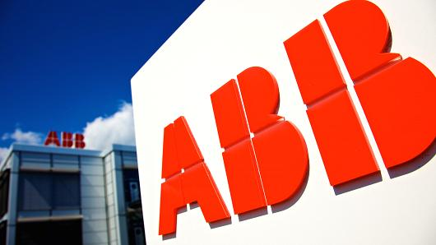
ABB (Asea Brown Boveri)
What they did
  Organized around mini-units
  Empowered its workers
  Flattened its hierarchy
  Eliminated central staff

Slide 19
ABB (Asea Brown Boveri)
How they did it?
  Disorganized 215,000 employees to 5,000 mini-companies of 50 workers each (Percy Barnevik)
  Each company run by its own manager having 3-4 lieutenants
  Cos. Made autonomous with empowered employees
  Only 3 management levels (13-250-5000)
  Eliminated most of the headquarter staff

Slide 20

SPLIT…!!!
What they did?
  Eliminated 140,000 jobs
  Promotion of communication between firm’s units to speed up decision making
  Organized into 3 major business
  Operations committee including heads of these business
  Interdepartmental teams
  Empowering employees
  Boss never locks his office/boundary-less
  Associates not subordinates
  Disseminating new values (Respect for individuals, dedication to helping customers, integrity, innovation and teamwork)

Slide 21
SATURN COROPORATION
Progressive and responsive
Part of General Motors Corporation
Teams of 10-12 heading the shop floor activities
No supervisors
Own hiring
Own budgets
Own quality

Slide 22

Empowerment
Elimination
Flattening
Downsizing
Values
Autonomy
Interdepartmental
approach
No subordinates
Only associates
SATURN CORPORATION
Promotion of
communication
No boundaries
No supervisors
Managing own work, hiring and quality

Slide 23

How the three organizations approached the same vision differently?
What must be the pace of such a transformation?
Is it valid for all kinds of organizations?
What could be the negative side of such a transformation?
Is it valid in all kinds of cultures?

Slide 24


